Slide 1
Customer Segmentation
using un-supervised Machine Learning

Slide 2
Data Dictionary
CUST_ID : Identification of Credit Card holder
BALANCE : Balance amount left in their account to make purchases
BALANCE_FREQUENCY : How frequently the Balance is updated, score between 0 and 1
PURCHASES : Amount of purchases made from account
ONEOFF_PURCHASES : Maximum purchase amount done in one-go
INSTALLMENTS_PURCHASES : Amount of purchase done in installment
CASH_ADVANCE : Cash in advance given by the user
PURCHASES_FREQUENCY : How frequently the Purchases are being made, score between 0 and 1 ONEOFFPURCHASESFREQUENCY : How frequently Purchases are happening in one-go, score between 0 and 1
PURCHASESINSTALLMENTSFREQUENCY : How frequently purchases in installments are being done
CASHADVANCEFREQUENCY : How frequently the cash in advance being paid
CASHADVANCETRX : Number of Transactions made with "Cash in Advanced"
PURCHASES_TRX : Numbe of purchase transactions made
CREDIT_LIMIT : Limit of Credit Card for user
PAYMENTS : Amount of Payment done by user
MINIMUM_PAYMENTS : Minimum amount of payments made by user
PRCFULLPAYMENT : Percent of full payment paid by user
TENURE : Tenure of credit card service for user
(1 = frequently purchased, 0 = not frequently purchased)

Slide 3
Problem Statement:
Segmenting the customers, that are benifical/risky to the bank
No Labels are defined in the training data.
Implementing un-supervised learning to visualize the customer segments
Problem Solving Approach:
This machine learning problem is to create segments of customers and is not going to deal with predictions with current implementation. Provided a test data, customers can be evaluated to identify their respective segments.
Majority of the data is float/int. Missing value treatment is done with mean of the attributes.
Implemented K-means clustering algorithm for mark the customers into segments.
Identified the high co-relation attributes and removed for further analysis.
Implemented elbow curve technique to identify the optimum number of clusters.

Slide 4
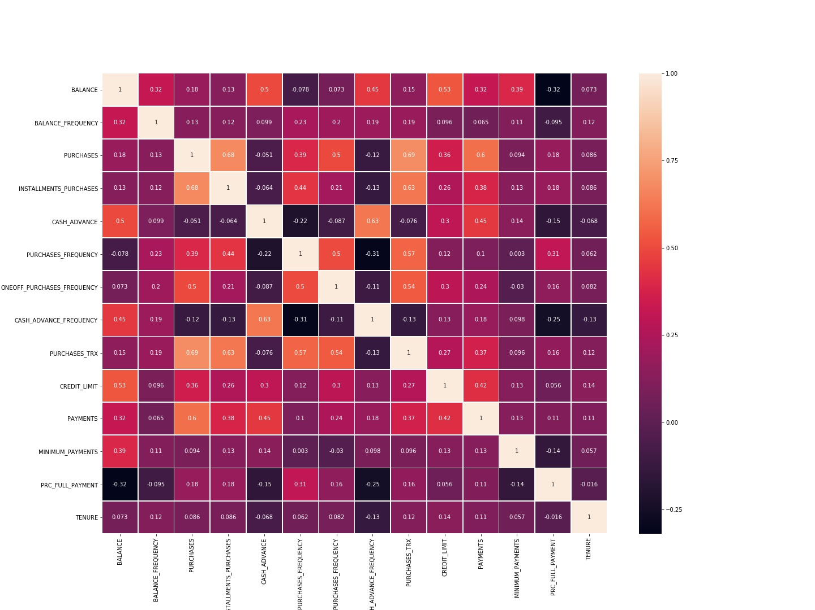

Slide 5
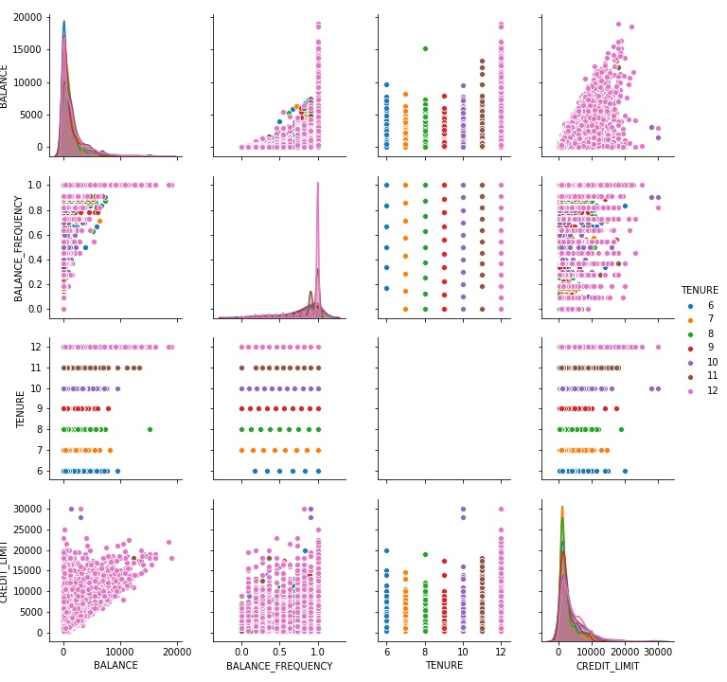
Key Analysis on Balance related attributes:
1. Distribution of Balance, Balance frequency and credit limit clearly skewed.
2. Though there are 6 levels of tenure, density is more towards 12 months of tenure (tenure is assumed in months)

Slide 6
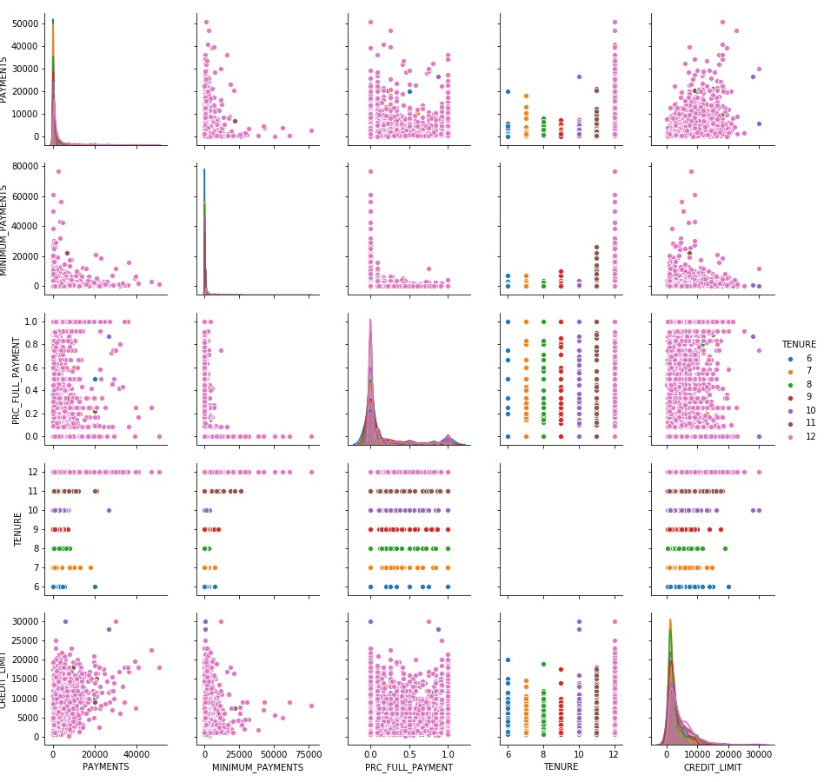
Key points on Payments related attributes:
1. Payments done by user are very minimal compared to the distribution. Minimum payments done by user seems to follow similar pattern of payments.
2. This raises, Majority of the payments are minimum payment due
3. Though there are 6 levels of tenure, density is more towards 12 months of tenure (tenure is assumed in months)

Slide 7
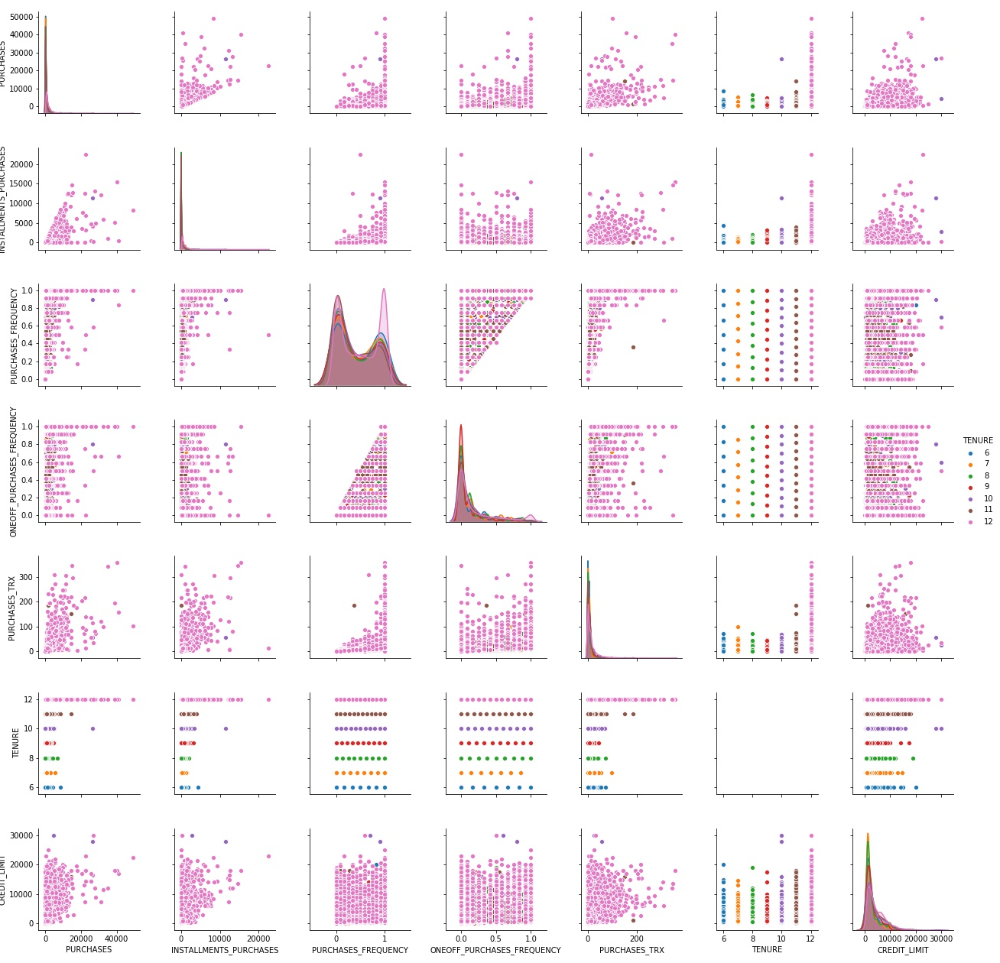
Key points on purchase related attributes:
1. Strangely, similar pattern observed in the distribution of payments and minimum payments is also observed for purchases and installment purchases.
2. distributution of Purchase frequency for tenure 12, is nearly uniform. It implies that, customers having less purchase frequnency is simliar to more frequent buyers.
3. Also, for rest of tenures (6 to 11), it implies, less frequent customers are more in number compared to more frequent customers.
4. Having higher credit limit is not increasing either purchases or installment purchases. This could be a risk to bank.

Slide 8
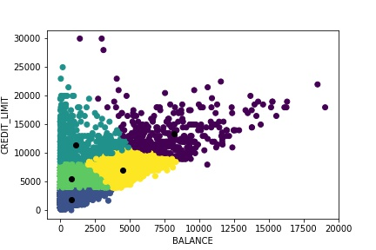
Customers are divided into 5 segments (as per elbow curve to identify the optimal number of segments).
Below are the key points:
a. violet segment:
b. yellow segment: Are the customers, having sufficient balance as almost equal to credit limit. This section could be, idle customers.
Notes:
BALANCE : Balance amount left in their account to make purchases, CREDIT_LIMIT : Limit of Credit Card for user

Slide 9
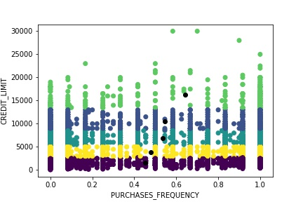
This clearly shows purchase frequency is increasing with increasing of credit limit.

Slide 10
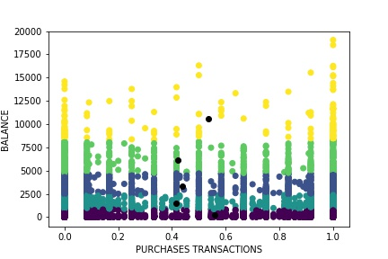
The lower segment, indicates that, thought account balance is low, number of transactions are higher. The number of transactions are almost equal to the number of high balanced customers.
Bank can focus the customers belong 2nd, 3rd and 4th segments, on improving number of transactions.
Notes:
PURCHASES_TRX : Numbe of purchase transactions made , BALANCE : Balance amount left in their account to make purchase

Slide 11
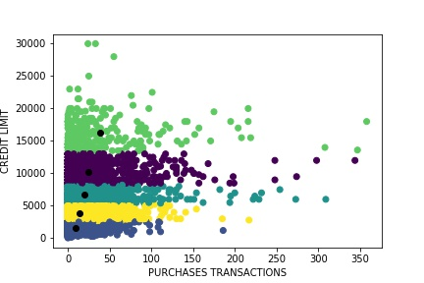
Below points from analysis:
It appears that, with the increase of credit limit, purchase transactions are gradually increasing. This is a good sign.

Slide 12
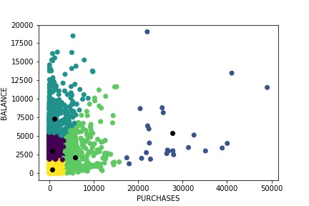
Below points from analysis:
For segments yellow, violet, and green, though balance amount is increasing but purchases are less. For the blue cluster, though balance is not too high, but purchases are comparitively more. These customers needs to inspected.

Slide 13
Improvements:
Customers can be labelled as low, medium and high on the basis of
PURCHASES_FREQUENCY
Cash advance frequency & Cash advance transactions
Percent of full payment paid by user
Impact analysis can be performed to understand the features affecting variations in above features. This can be dealt with supervised learning.
Created segments can be labelled appropriately to treat them accordingly.

